Slide 1


SYMPTOM HUNTER TEAM #2
Bustos Sánchez, Javier
He, Wenyu
Liu, Xiang
Manne, Anupama
Tang, Yewen
Zhang, Xujian

Slide 2
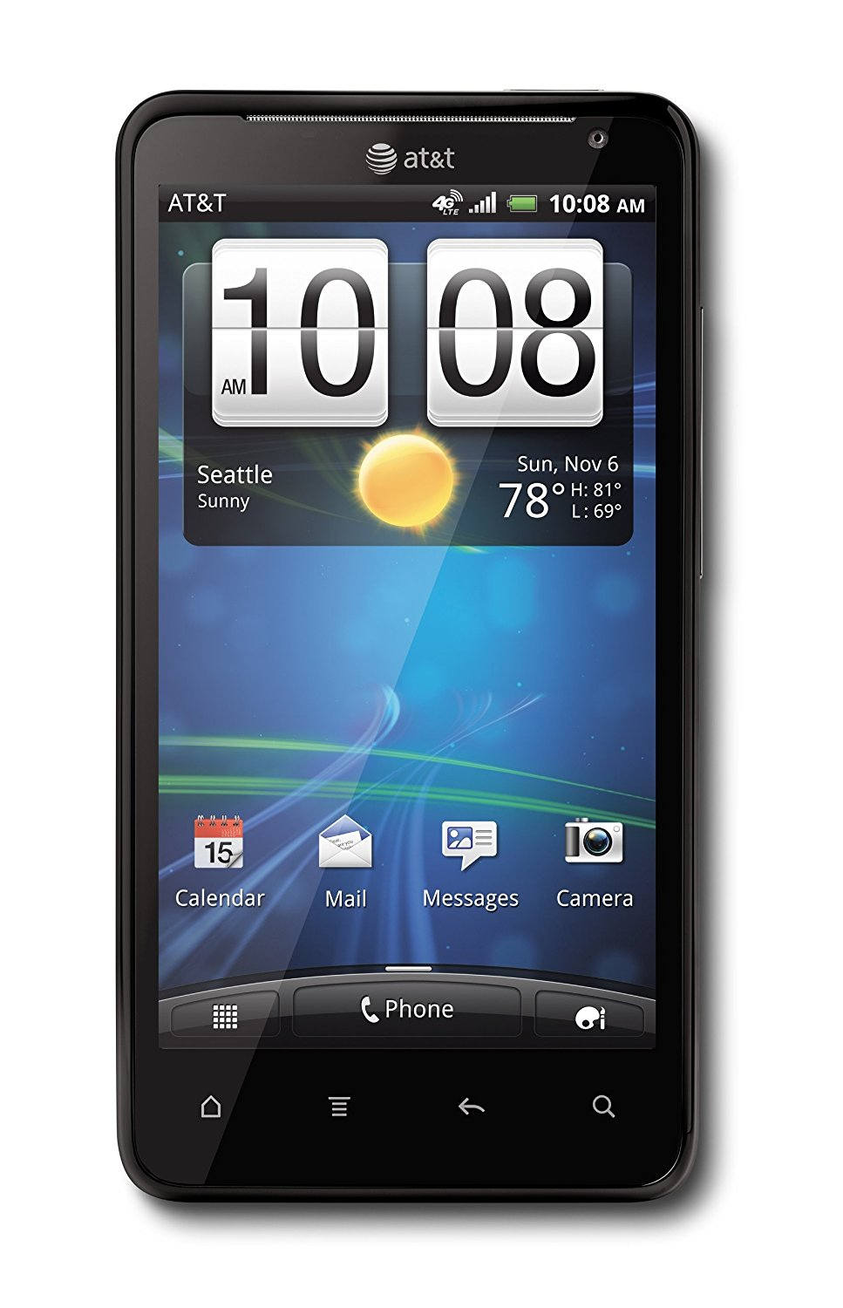
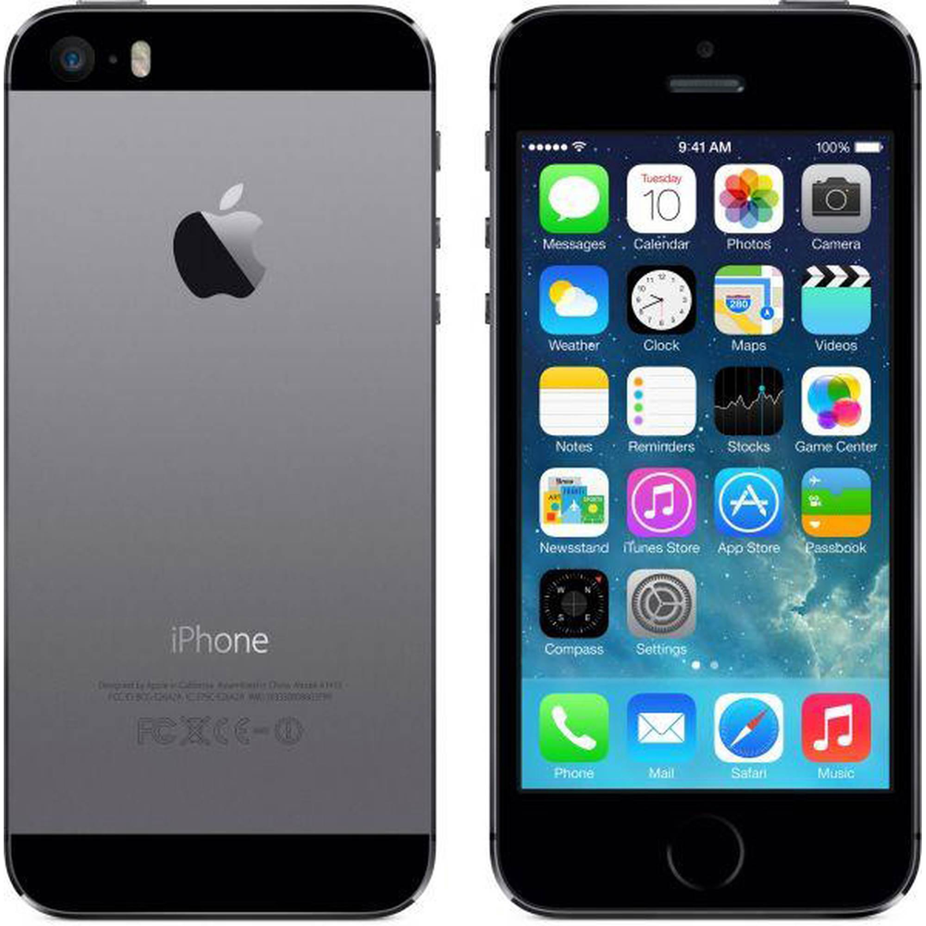
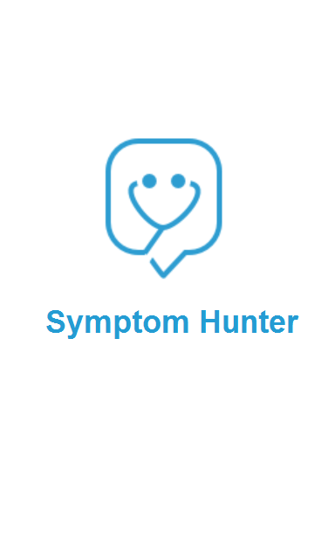
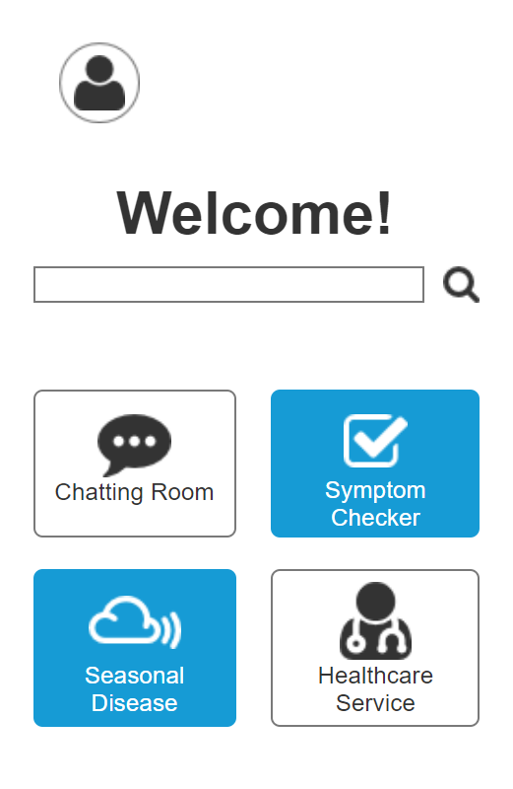
Introduction
Competitive Analysis
User Research
Personas, Scenarios and Flows
Prototype

Slide 3



Design Brief. Competitive Analysis
 | WEBMD | MEDIKTOR | YOURMD
Efficient Navigation
Organizational Clarity
Effective Visual Design
Adequacy of Information
Readability
Ease of Use
Provide Help
Main Functionality:
Symptom Check
Online Appointments
Challenges:
Reliability
Usability

Slide 4
User Research
Backgrounds of participants in our user research:
Age: 20 – 40 years old.
Gender: Male/Female.
Work/Study in various fields.
Have different acknowledgment in medicine/diagnosis.
Most of them are from foreign countries.
Does not get sick very often.
Questionnaire: google form
https://goo.gl/forms/gZaqvHPfUnmN2ZzZ2
Interview: face-to-face & Skype

Slide 5
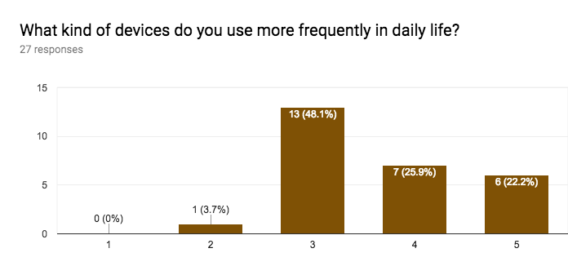
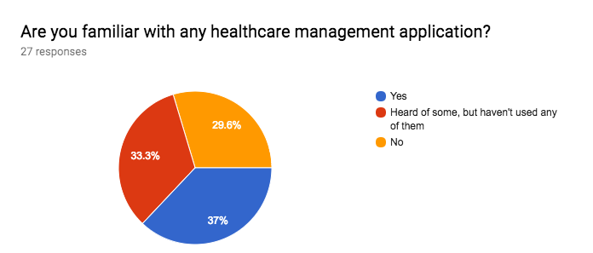
User Research

Slide 6
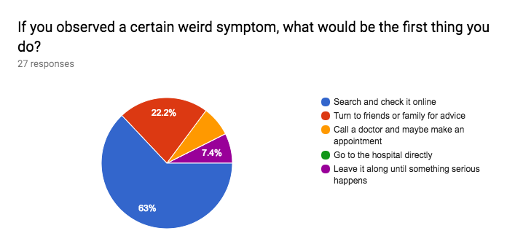
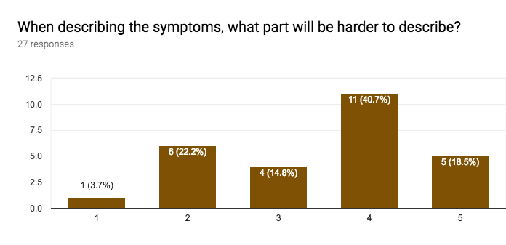
User Research

Slide 7
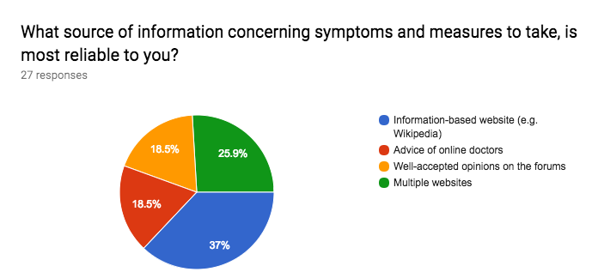
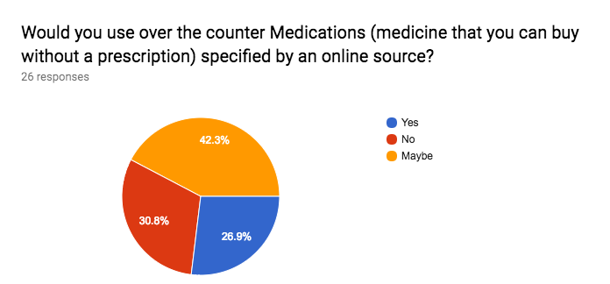
User Research

Slide 8
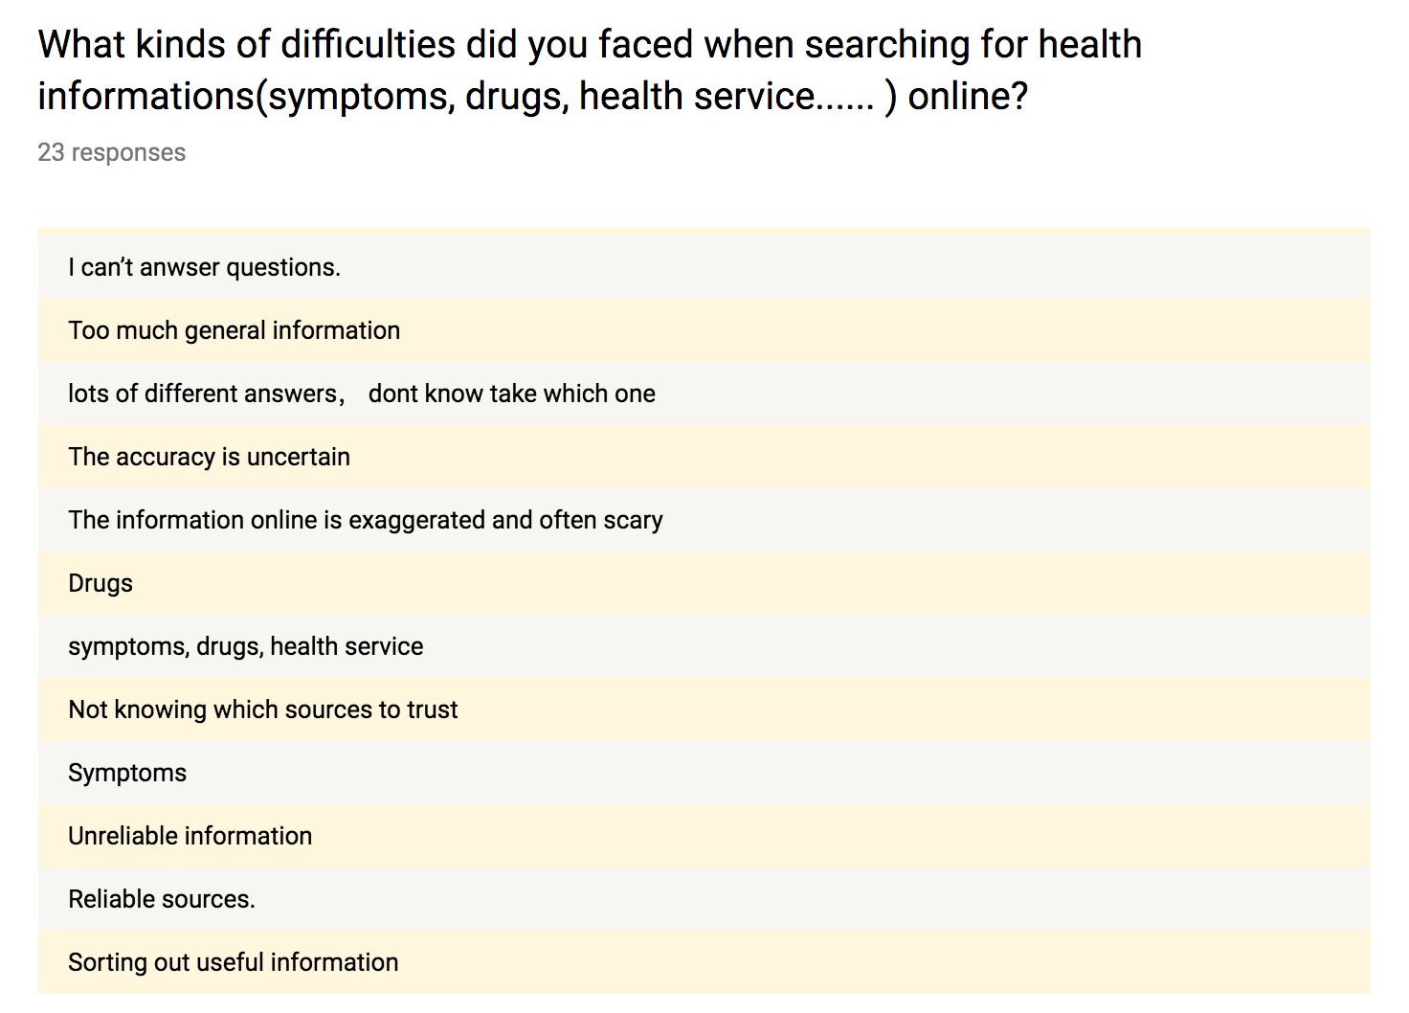
User Research

Slide 9
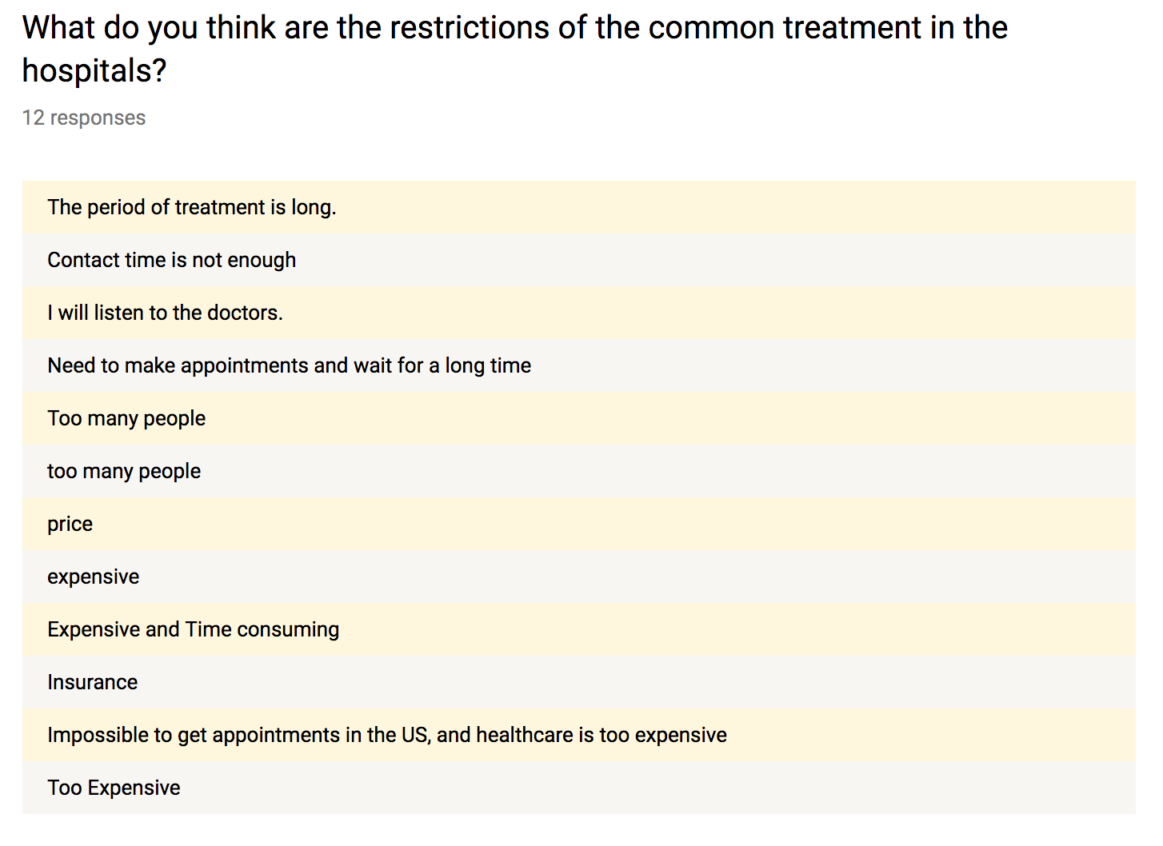
User Research

Slide 10
User Research
Highlights from the interview/questionnaire:
“Hospitals here are very expensive and time consuming. And most of the times I just fall sick because of the change in weather. ”
“It is easy to search a symptom, but a single symptom can be associated with many different diseases.”
“Just couldn’t find the symptom of whole body hurts rather than a particular place nor could I write a symptom of my own.”
“Hospital systems are built long ago so they are not efficient enough to satisfy patients’ need timely. I can’t tell objectively the restrictions because I work in the hospital.”

Slide 11
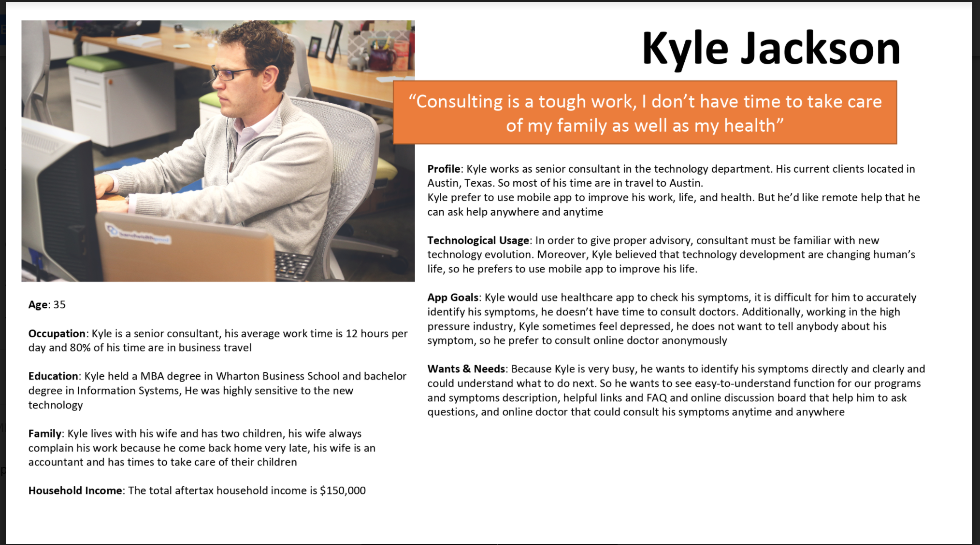
Personas

Slide 12
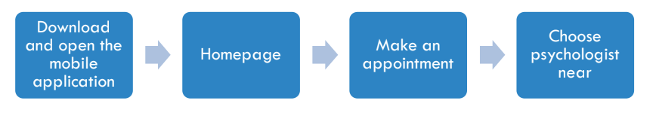
Scenario & User Flow
When Kyle finishes the telephone conference and looks at the watch, it is 10pm, he still remains a PowerPoint that will present to his clients in tomorrow morning. He is very tired, both mentally and physically, so he prepares to bring the work to home. When he gets back to home, two children caught a cold and keep crying, but he doesn’t have time to take care of them, he has to finish work.
However, his wife does not understand him and complain about his work. He is insomnia in that night and very pressure in both work and family’s burden. He feels anxious in his current situation. So he opens the healthcare app to check his symptoms and is wondering how to relieve his anxious. By searching the keyword, he finds out his symptom is periodic depressive disorder, so he prepares to make appointment with online doctor to consult his symptom...

Slide 13
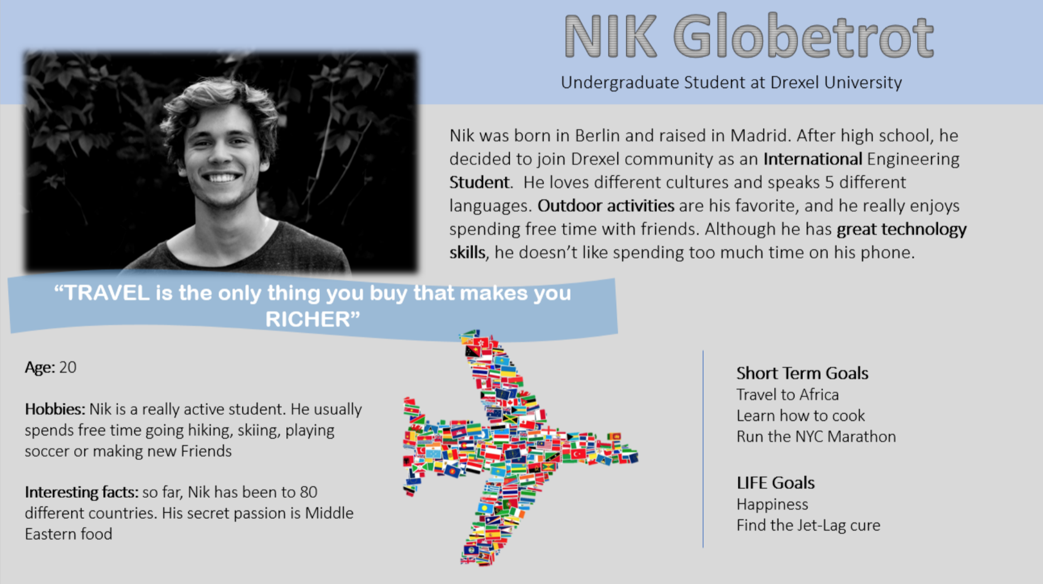
Personas

Slide 14
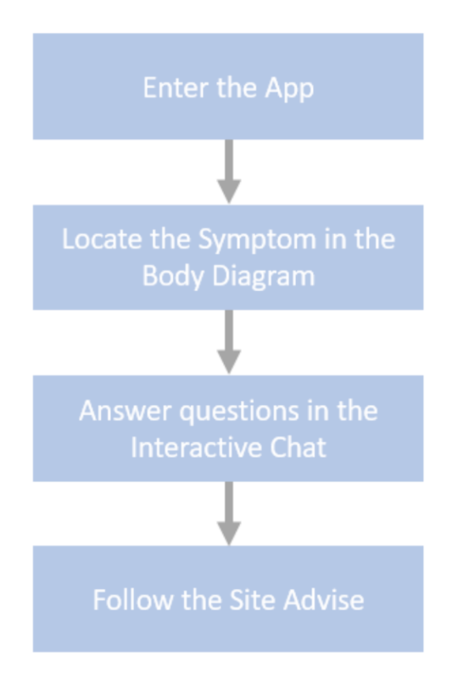
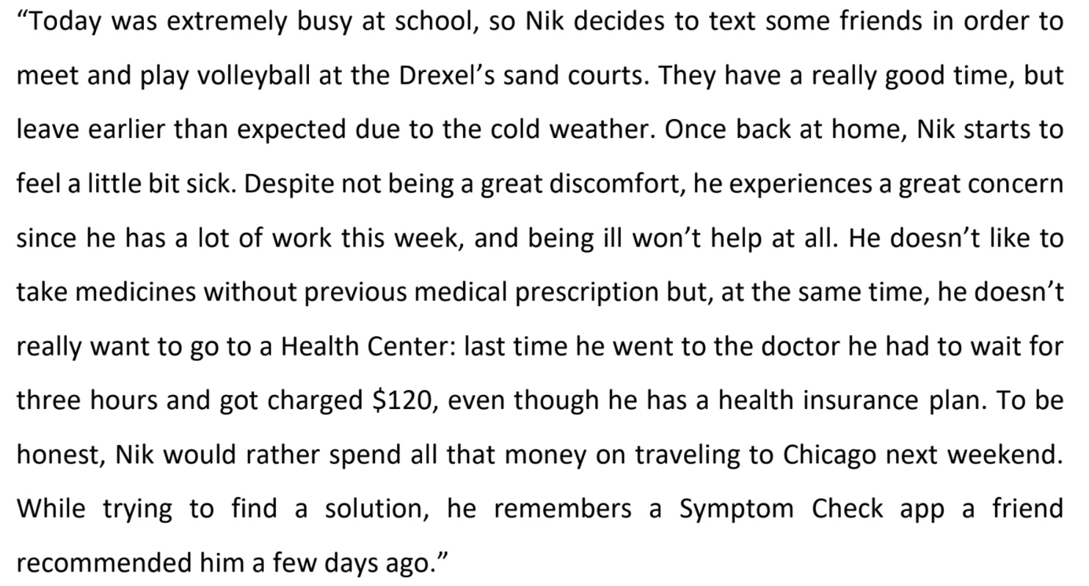
Scenario & User Flow

Slide 15
Final Prototype

Slide 16


